Slide 1
Adversarial attack on ML

Slide 2
Scope of FYP-II
Using CNN model to classify MNIST hand written dataset
Using GAN to craft adversarial examples

Slide 3
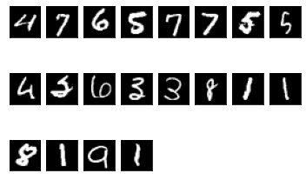
MNIST dataset
MNIST dataset is a dataset of hand written images
60000 train and 10000 test images

Slide 4
Methodology
CNN 2D model has been used with two sequential models and three linear layers.
Other hyperparameters are
SGD as optimizer
crossentopyloss to evaluate loss

Slide 5
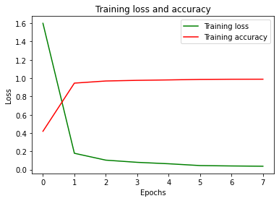
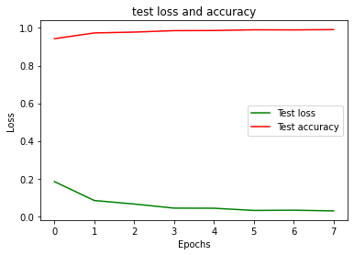
Result of classification
Train Loss and accuracy
Test loss and accuracy

Slide 6
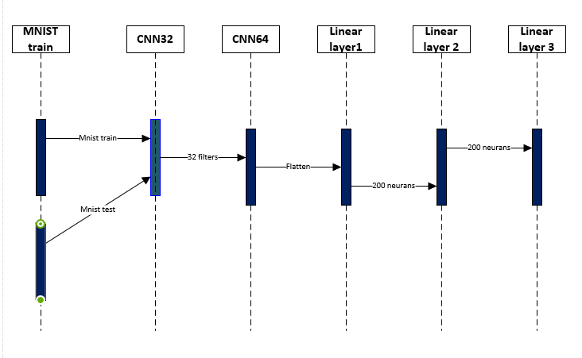
Sequence diagram

